Slide 1
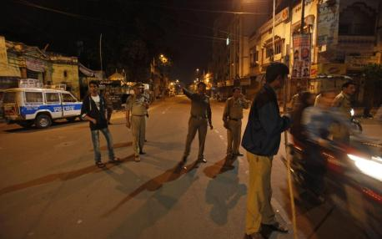

Slide 2
$
4.5

Slide 3
$
4.5
Billion

Slide 4
$
4.5
Billion
A N N U A L L Y

Slide 5
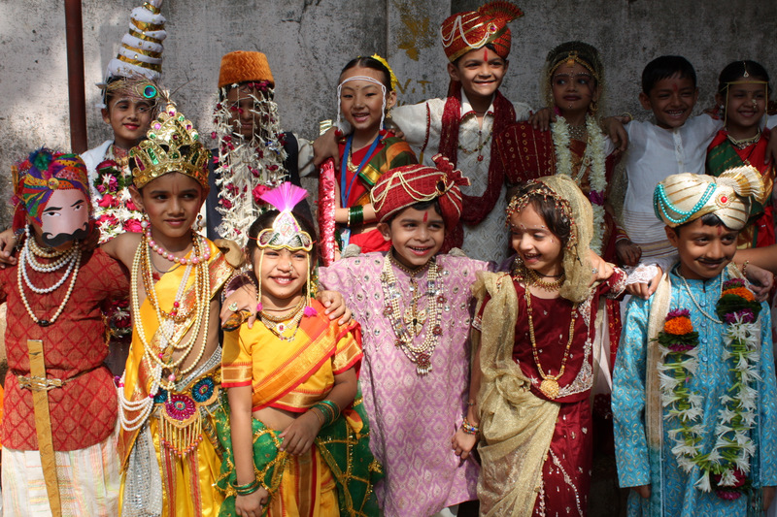

Slide 6
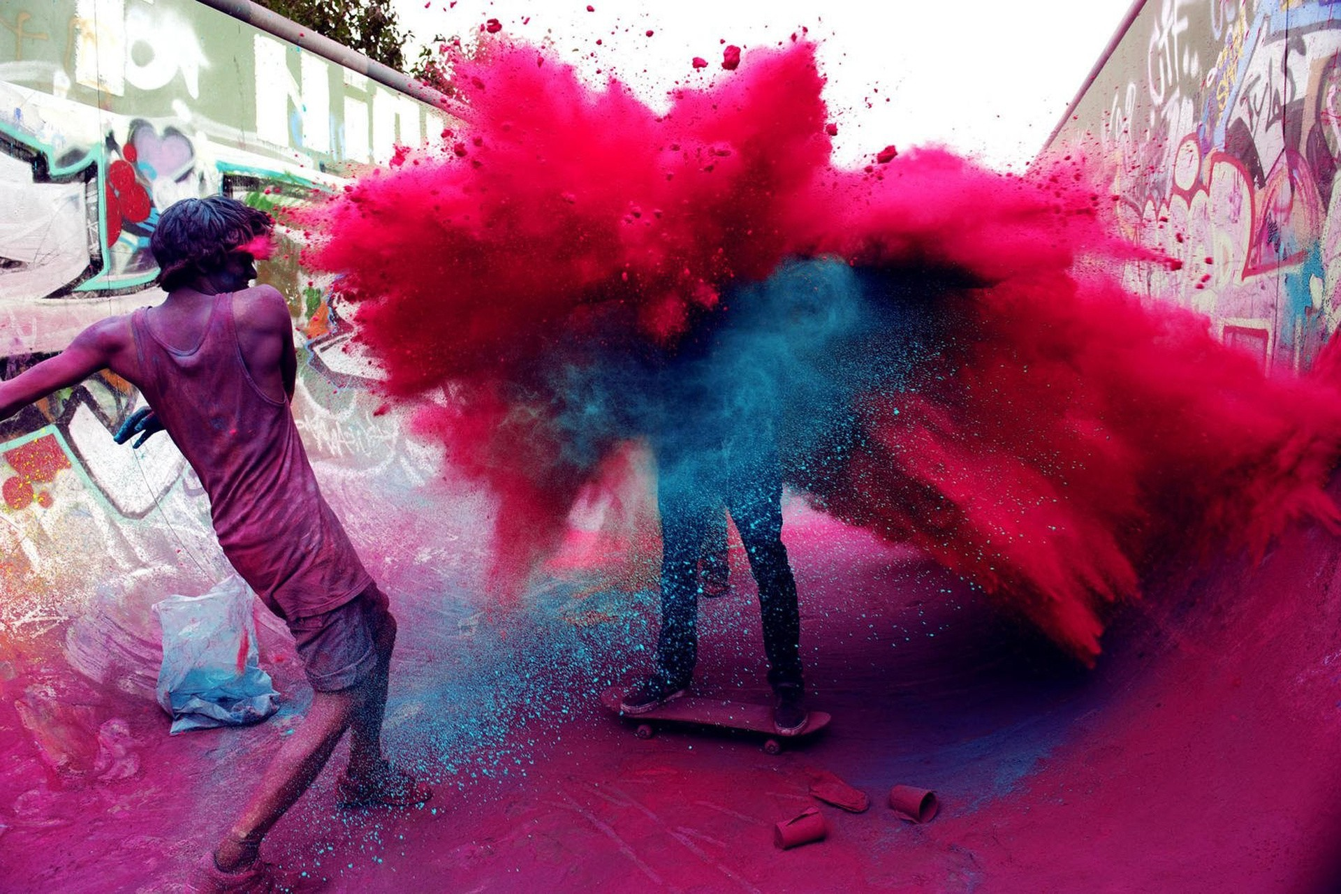

Slide 7
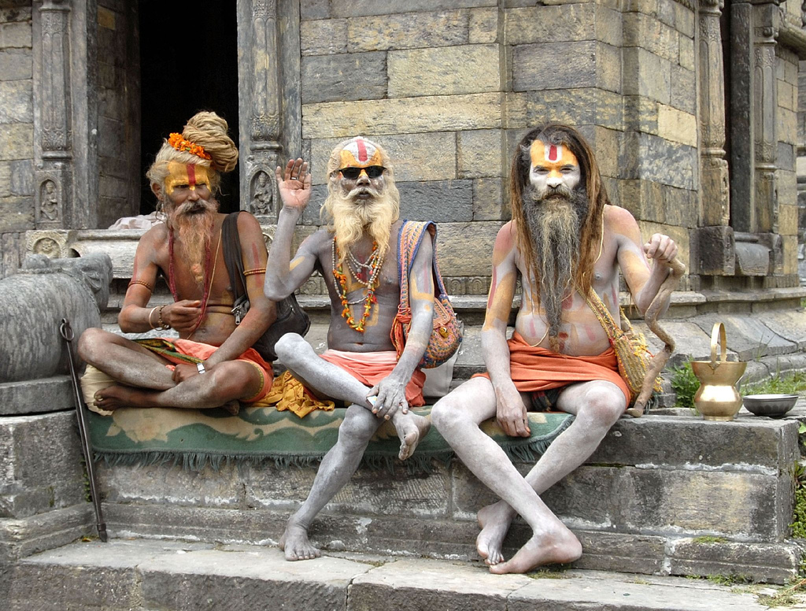

Slide 8
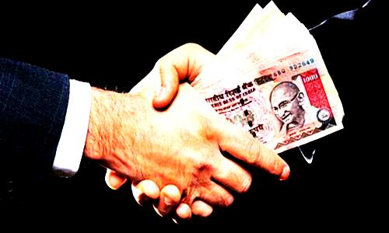
B R I B E S

Slide 9
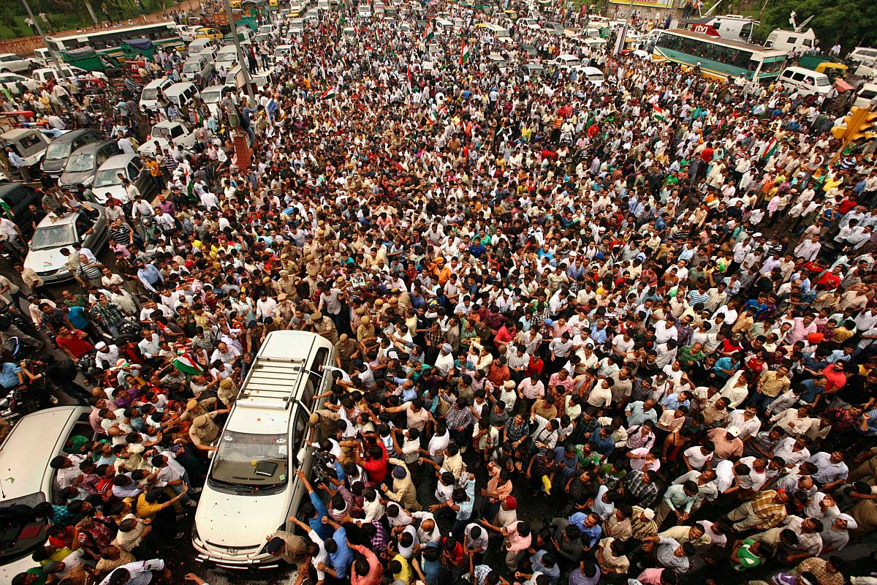

Slide 10
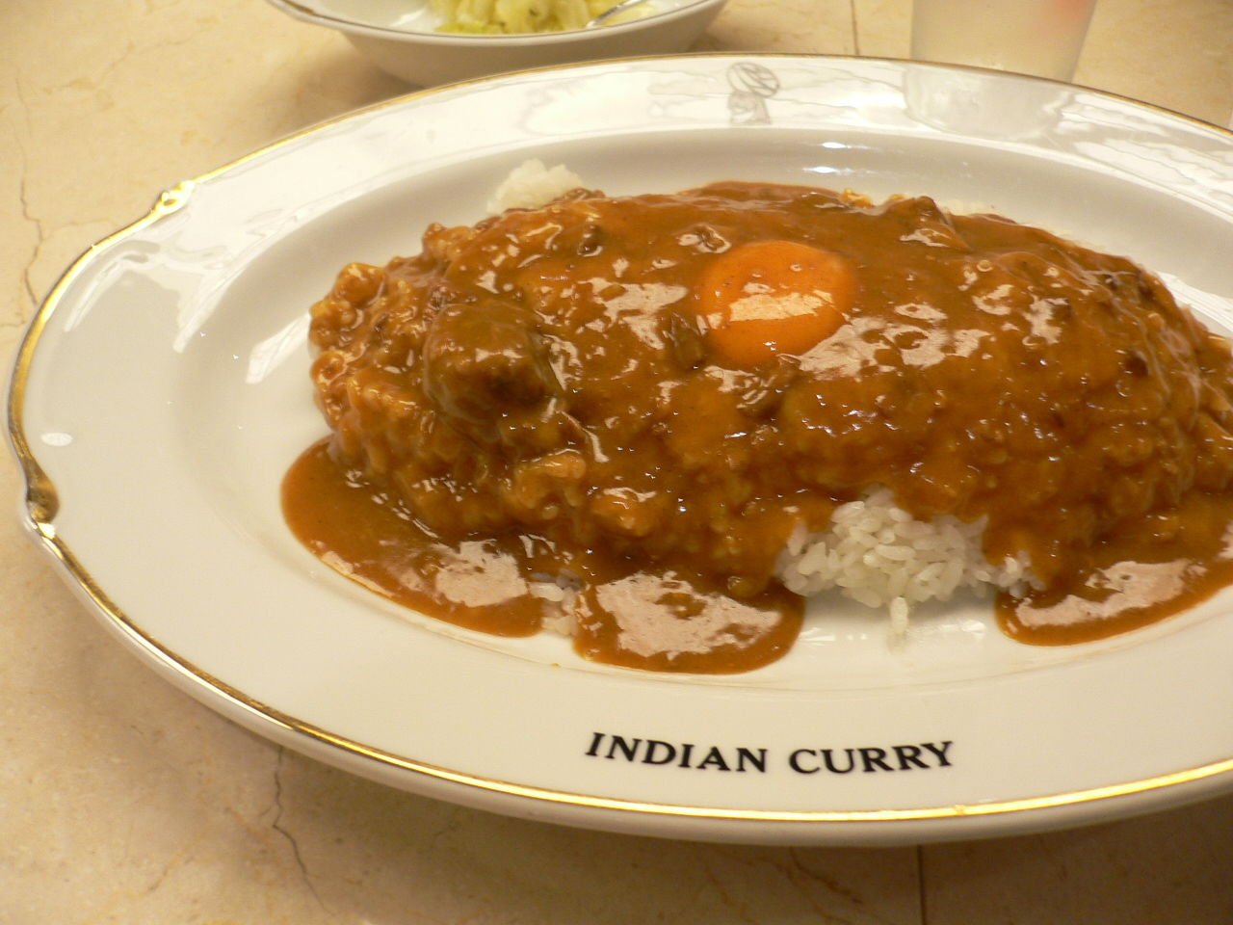

Slide 11
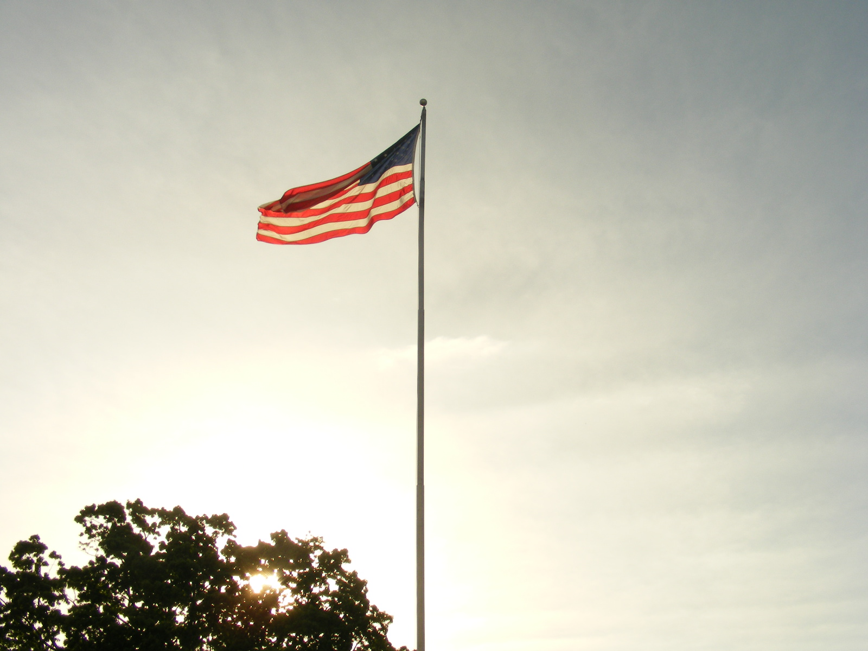

Slide 12
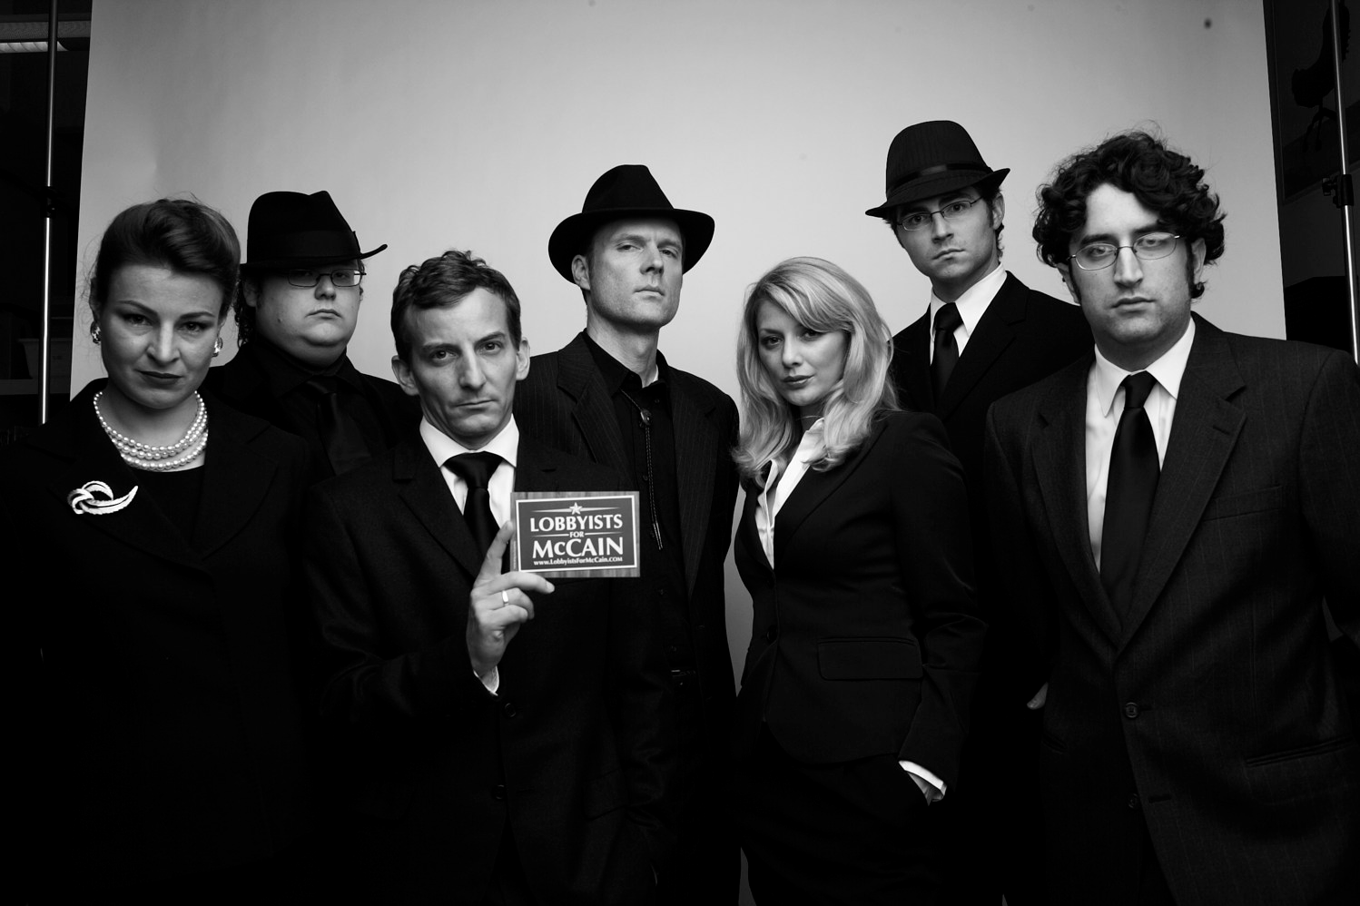

Slide 13
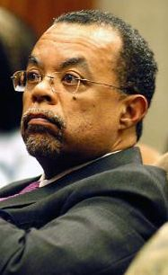
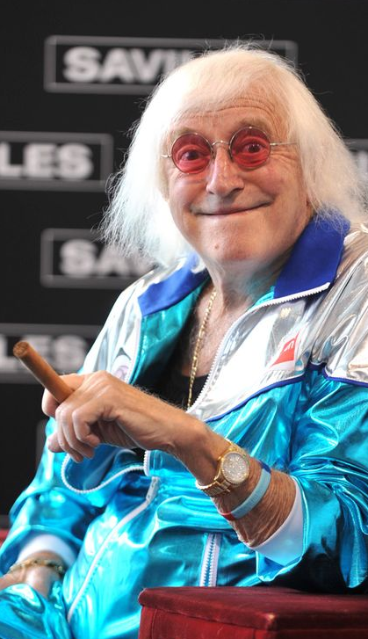
Jimmy Savile
Controversy
Skip Gates
Controversy

Slide 14
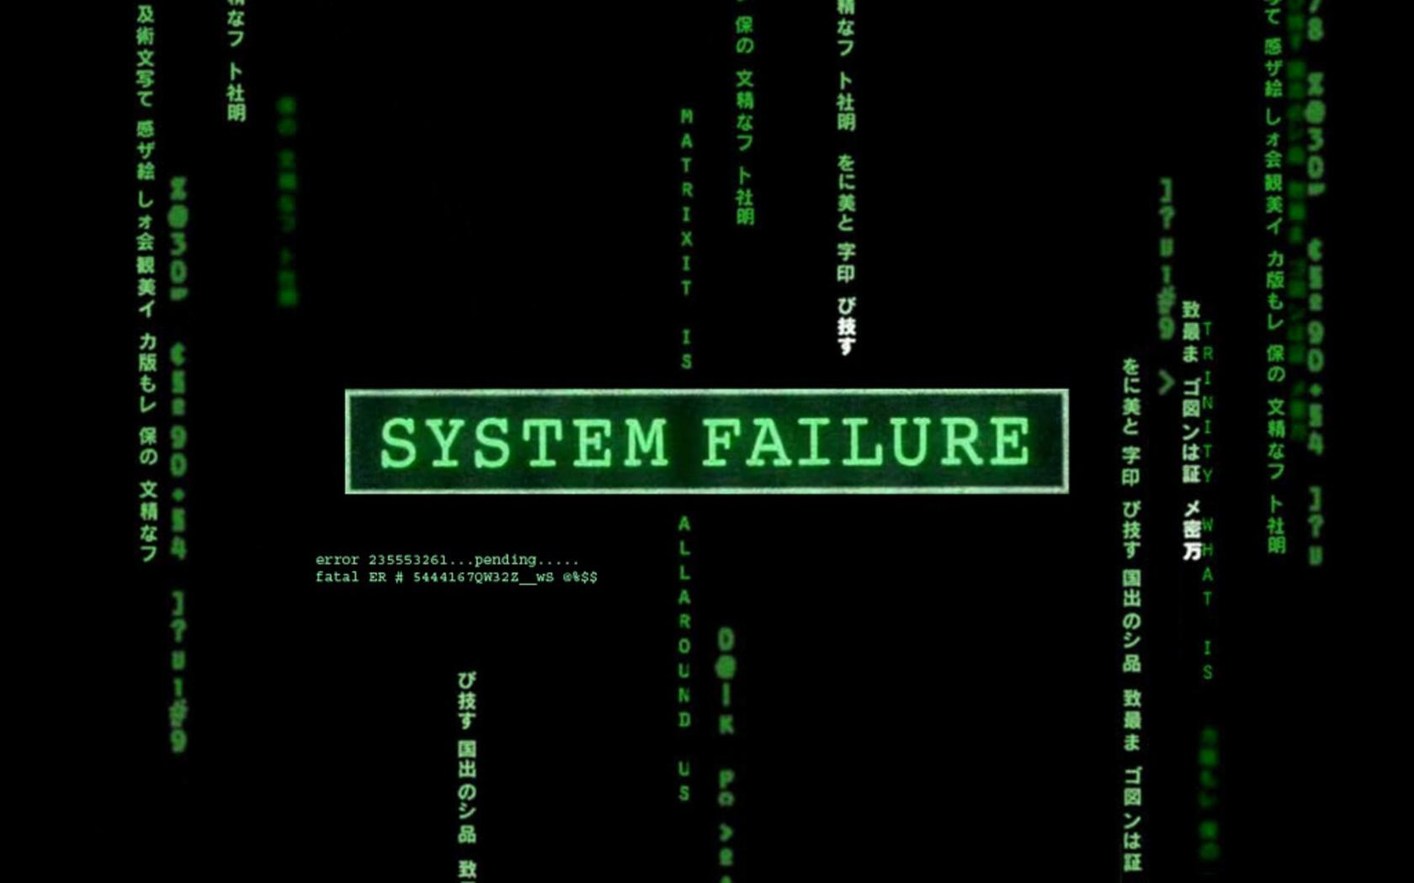

Slide 15
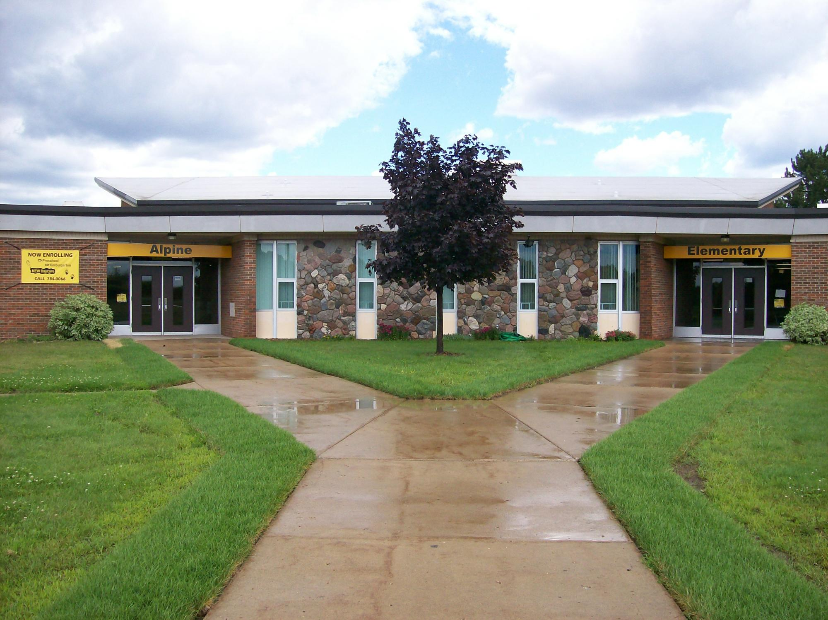

Slide 16
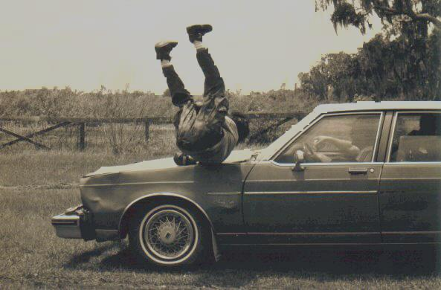

Slide 17
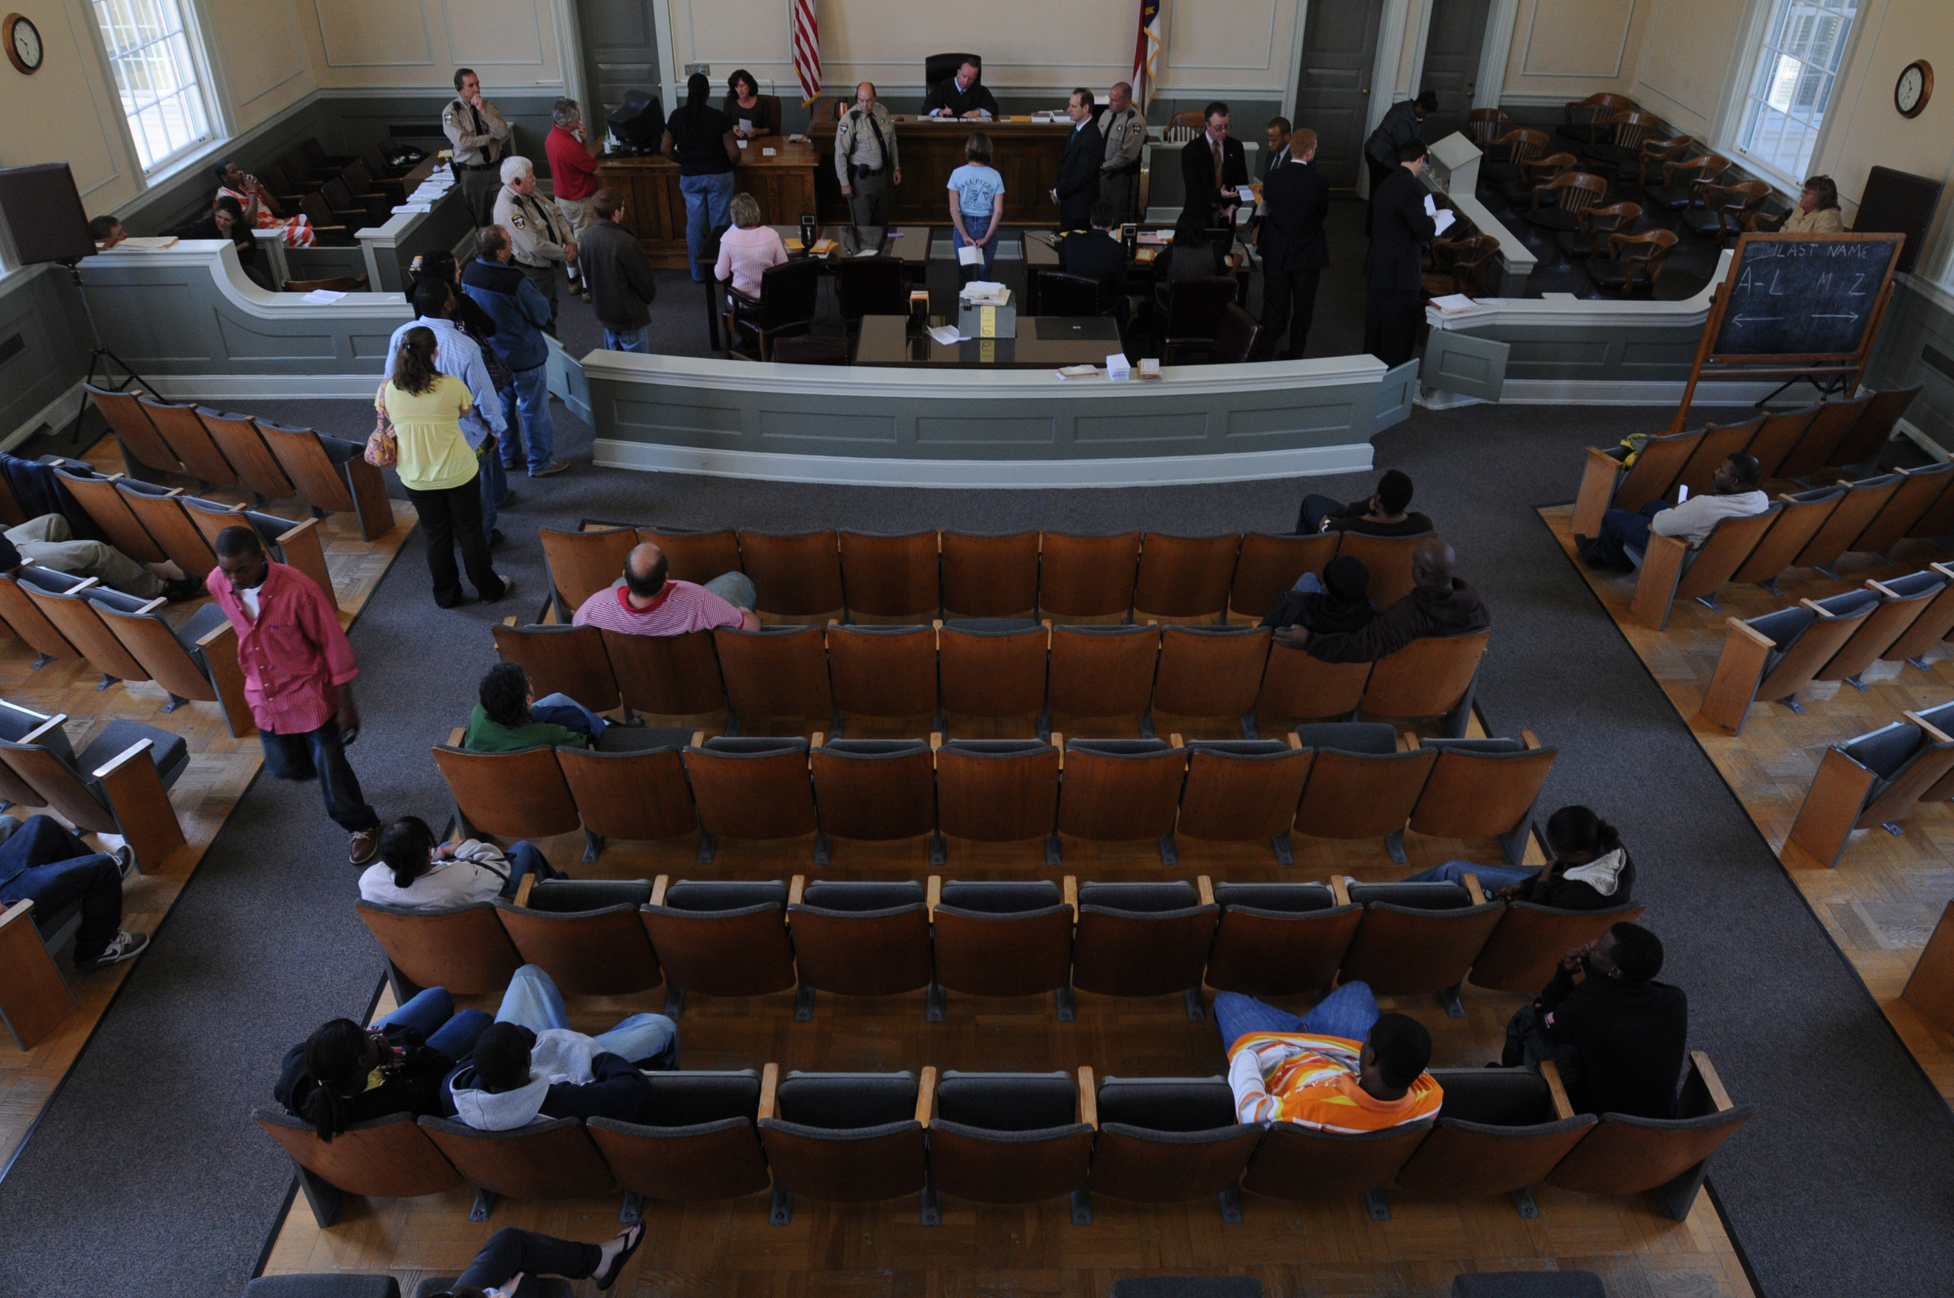

Slide 18
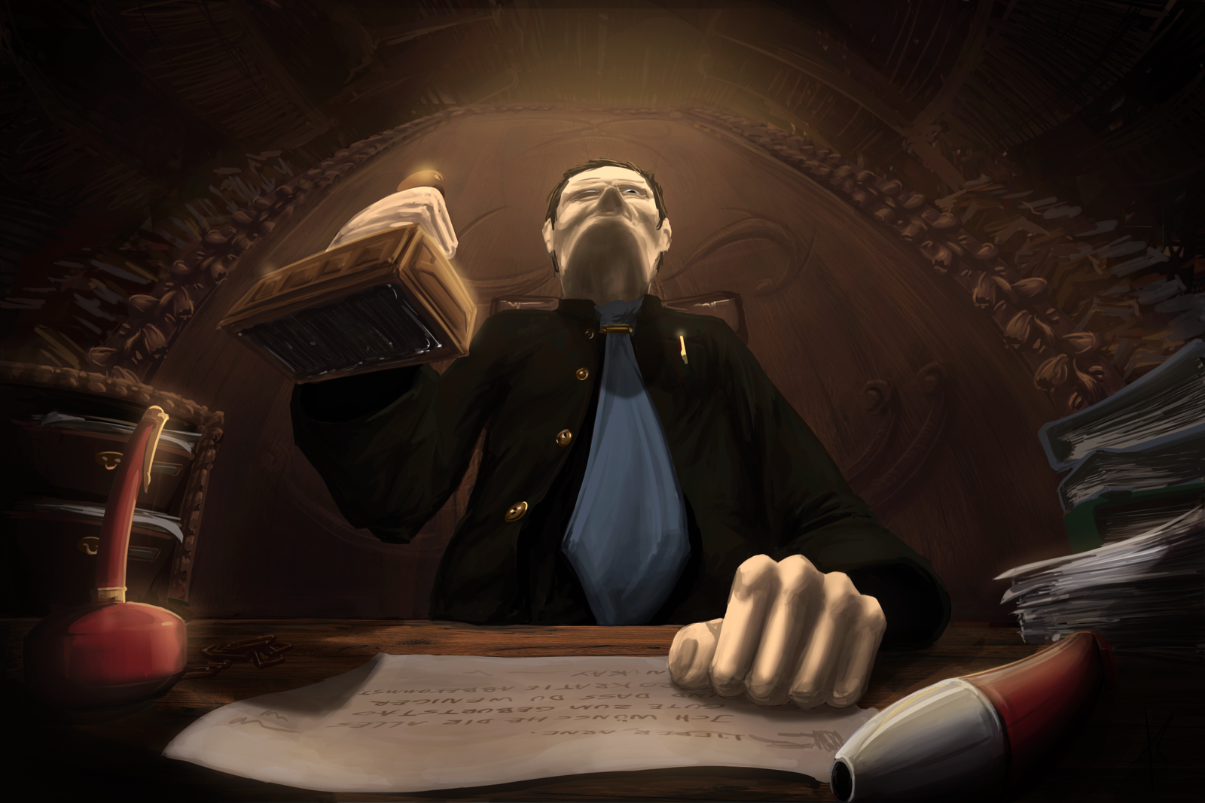

Slide 19


Slide 20
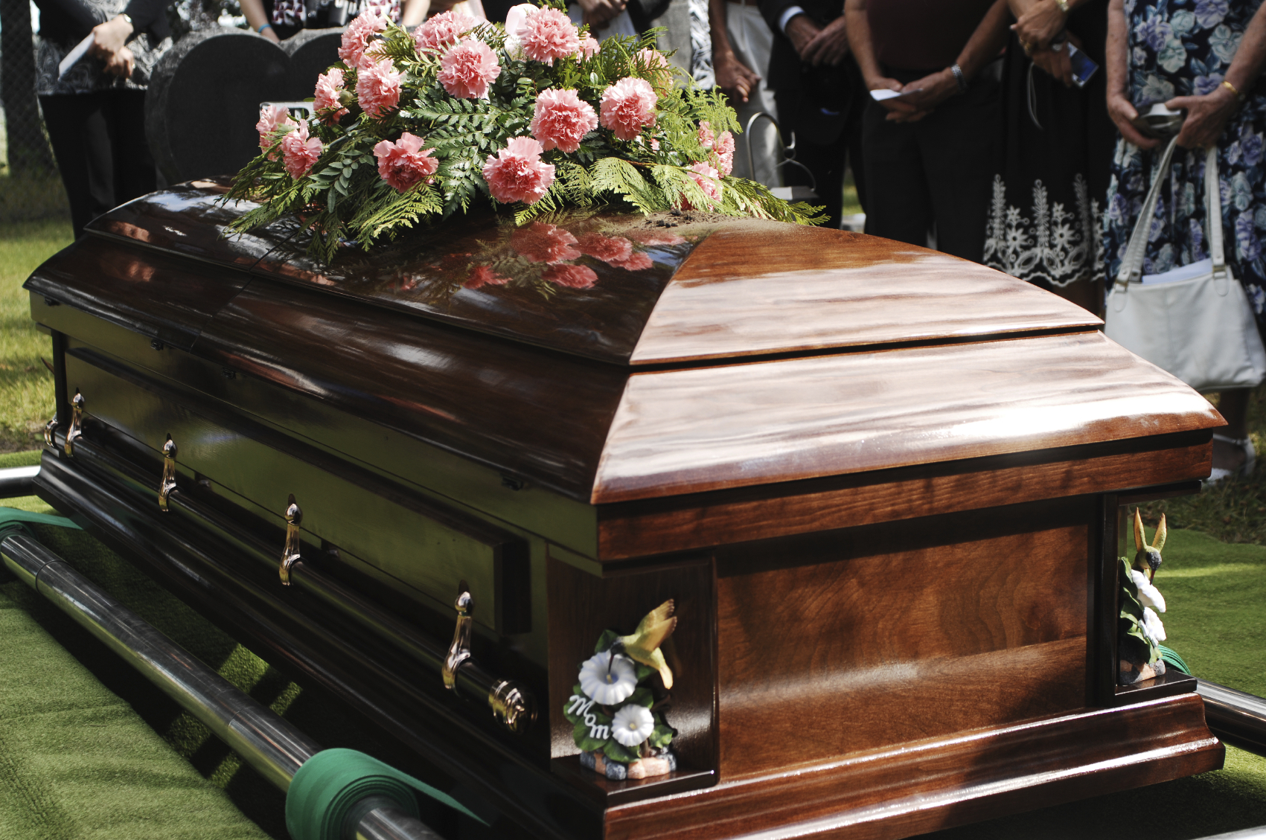

Slide 21
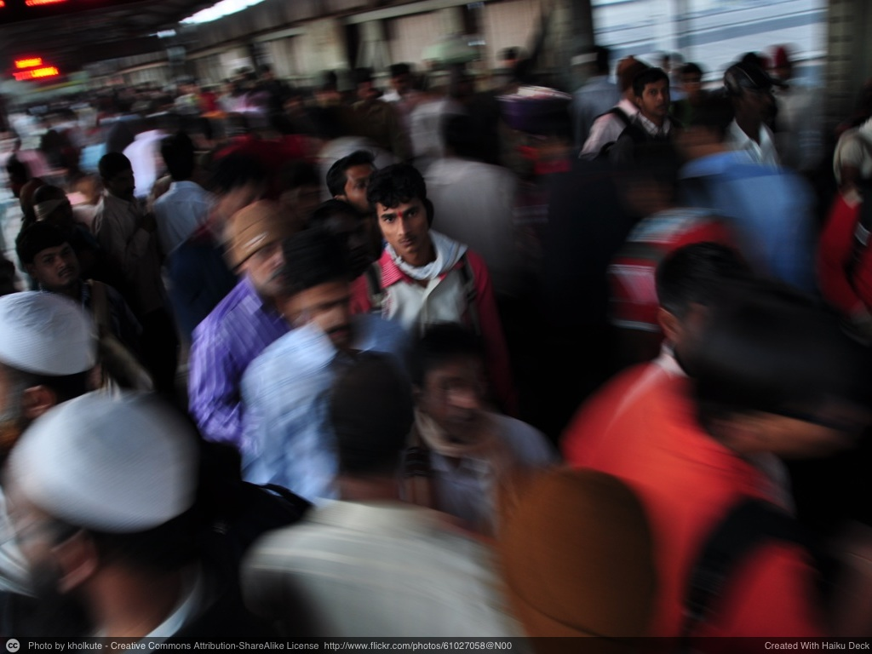

Slide 22


Slide 23
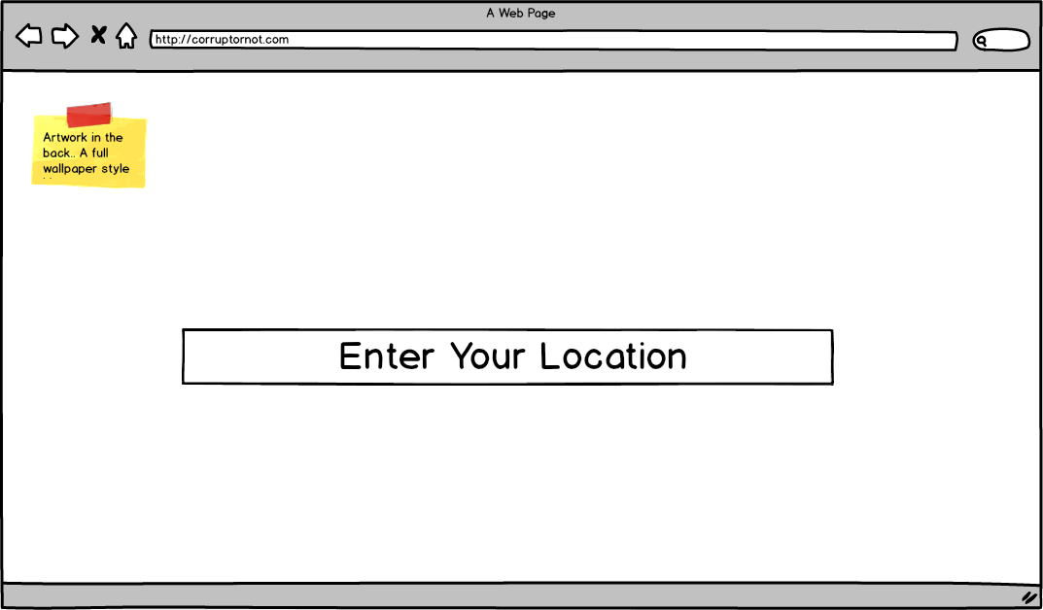

The mission of this website is to help you fight corruption.
Please take care of it.

Slide 24
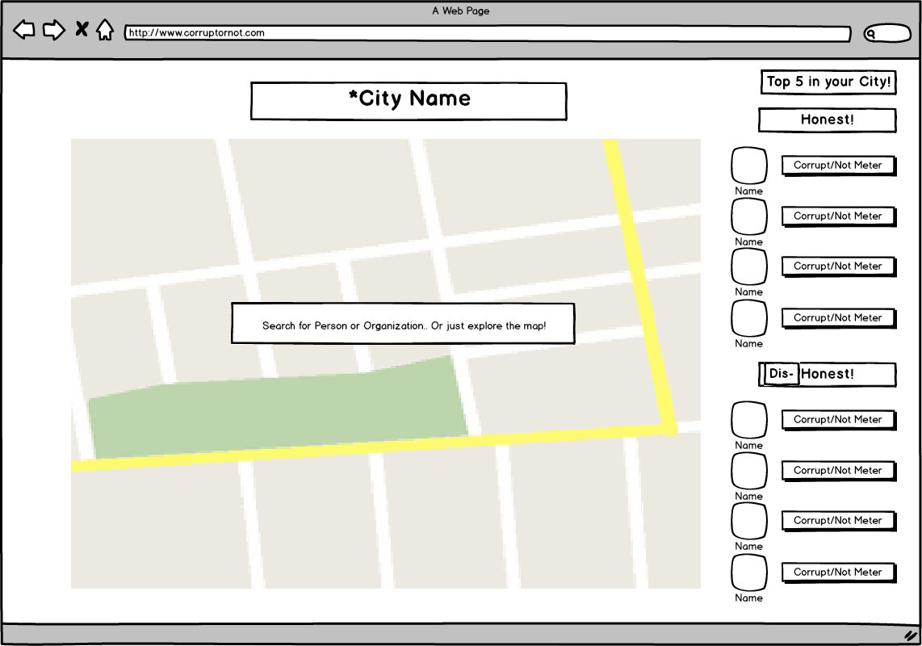



Slide 25
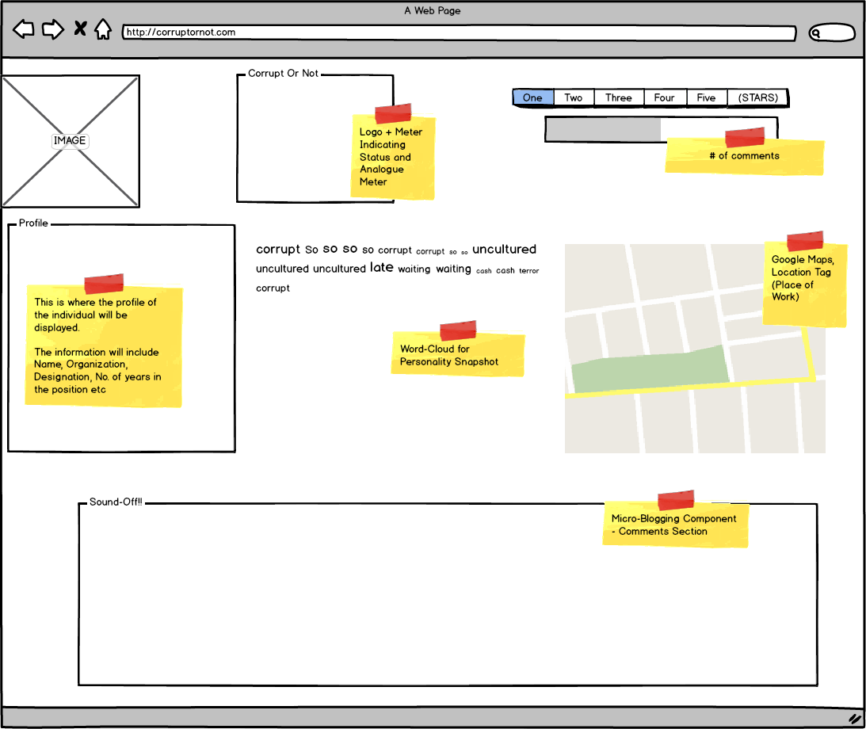

Corrupt or Not
Profile
Sound-Off!!
Anonymous1: I was asked to pay a bribe for driving on New Years of Rupees …
Anonymous2: This police officer is beyond corrupt!!! …
Anonymous3: ……….

Slide 26
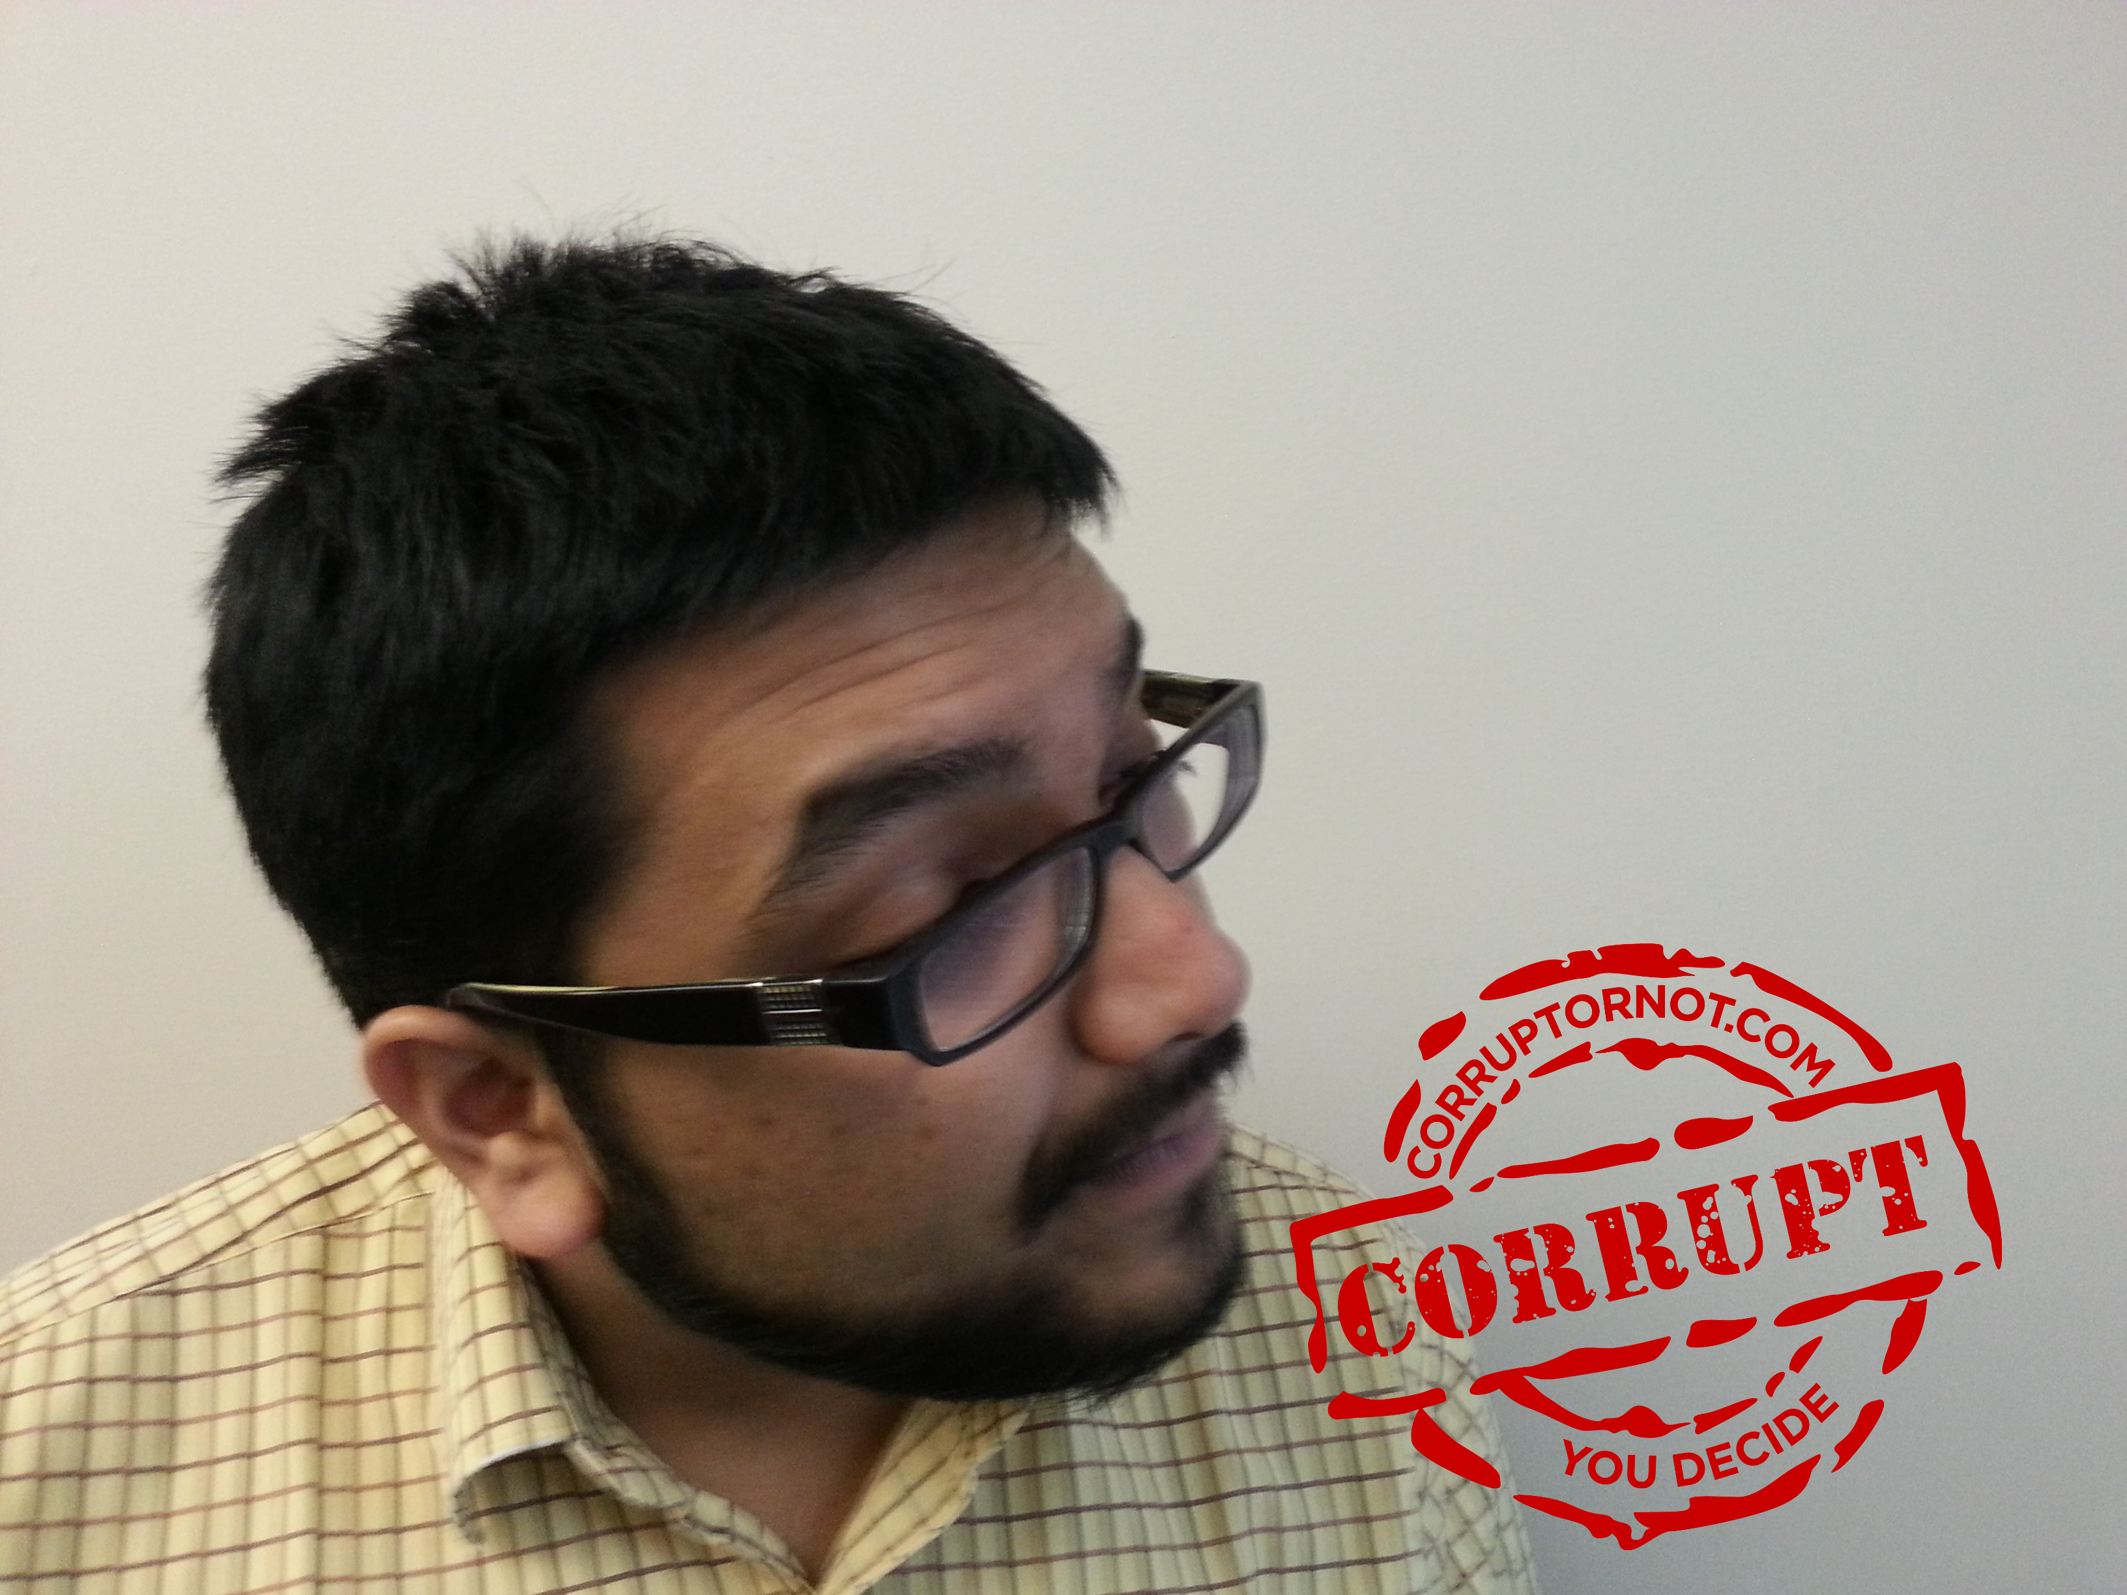

Slide 27
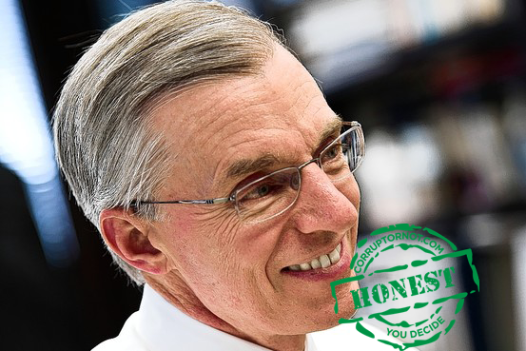

Slide 28
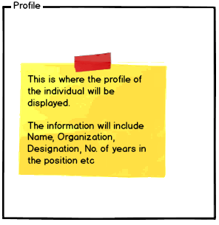
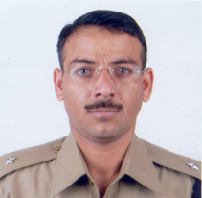



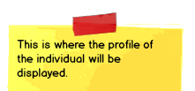

Profile
Badges
Discussion Platform
Kartik: The Mumbai University is very corrupt.
Vishal: Let take action!
Jessie: I am in!
Jon: me too!
Meenal: me three!
Group Participants
Vishal
Jessie
Jon
Meenal
Notes:
Different badges for different topics?

Slide 29
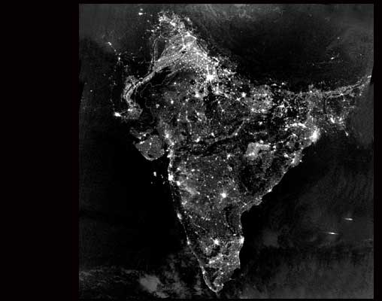
Connected:
135 Million

Slide 30
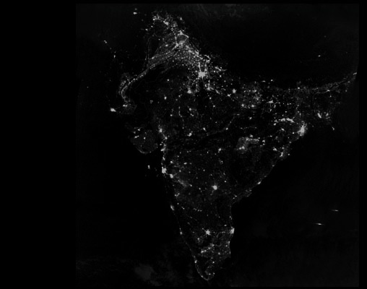
Tipping Point:
25 Million

Slide 31
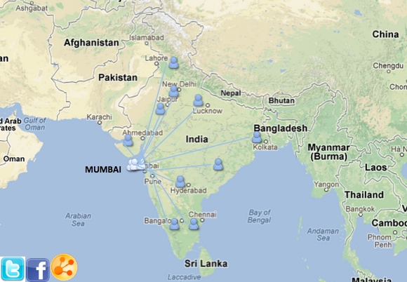

Slide 32

Phase III
1
year
1
year
6
months
Summer 2013

Slide 33


Slide 34








Slide 35






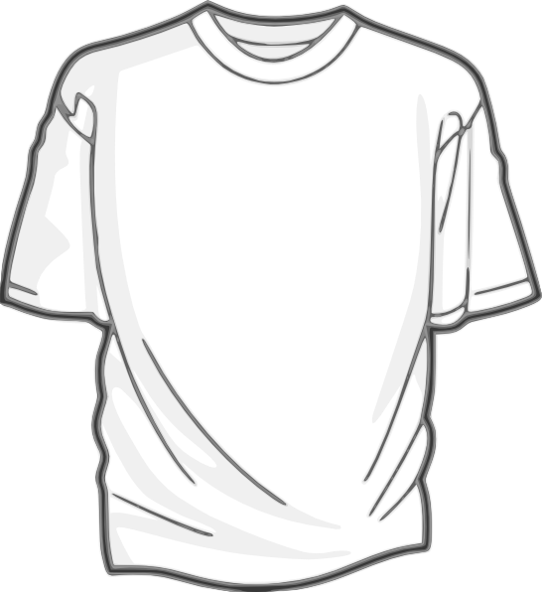






Donations
Sales
Fundraisers
Grants

Slide 36
Team Slide

Slide 37
20 K

Slide 38
Advertising
20 K

Slide 39
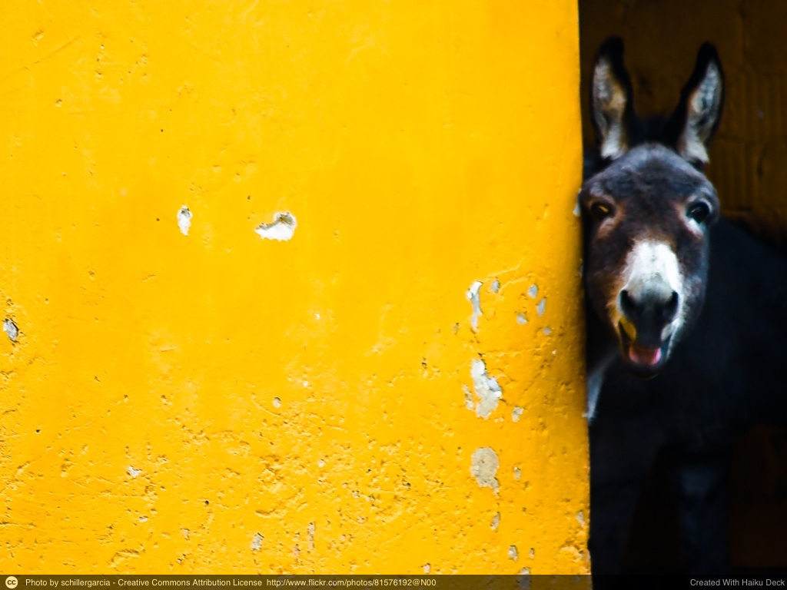

Slide 40
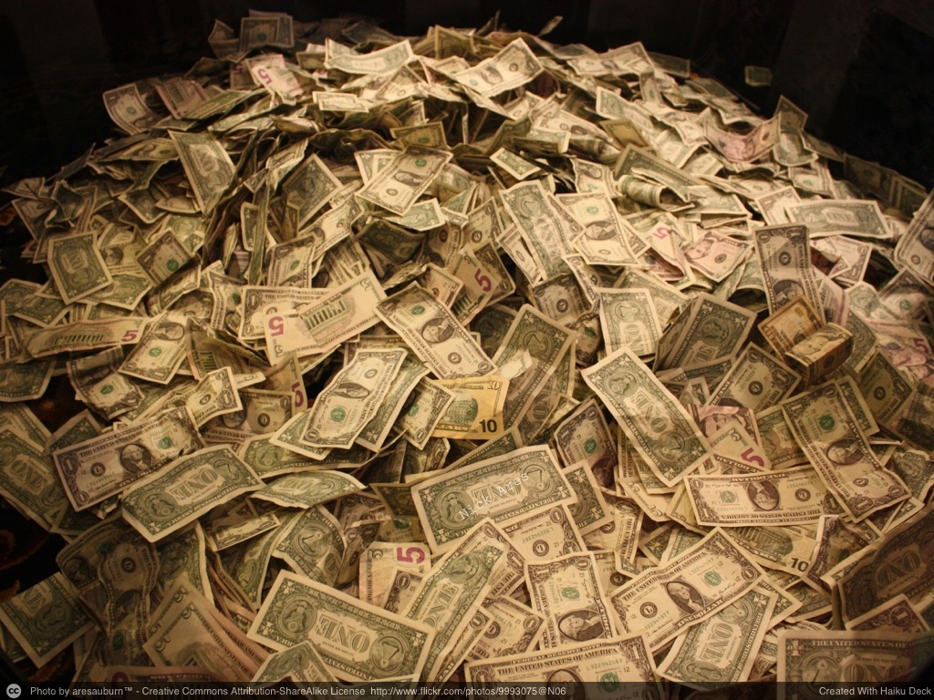

Slide 41
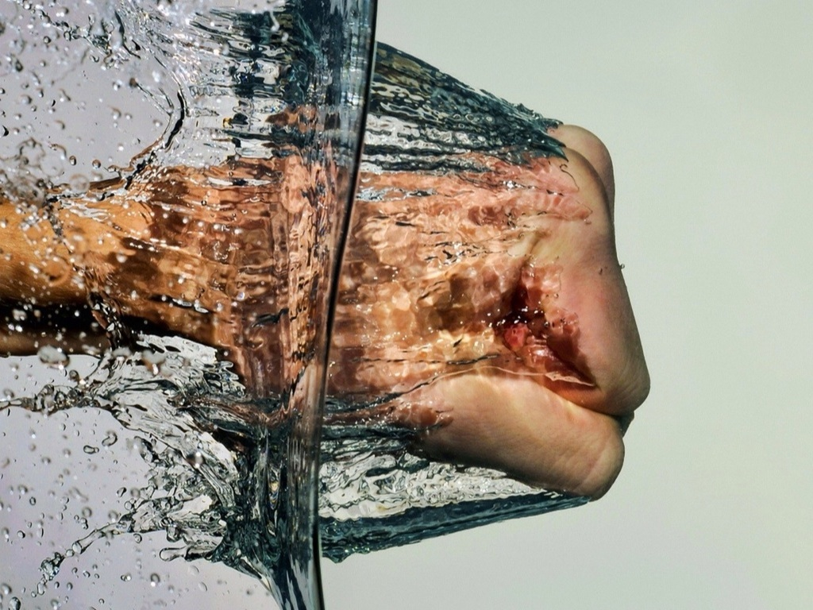

Slide 42


